Slide 1

Banking Database Management
Course: Database Management 1
Instructor: Prof. Dr. Melike ŞahDirekoğlu
Group Members:
Farhaneh Aryanejad
Amanuel Galema
Nathan Ngoyi
Joshua Omotosho

Slide 2
Introduction
Banking database management is essential for efficient handling of customer and transaction data in the system.
We have designed the database to efficiently manage essential operations and ensure data integrity.
It connects core entities such as accounts, customers, employees, branches, loans, and transactions.
The schema supports critical functionalities like account management, loan processing, transaction tracking, and card services.
We have organized the structure to ensure seamless collaboration between various banking operations, enhancing overall efficiency and customer satisfaction.

Slide 3
The Database Design and Implementation Steps
Step One
Step Two
Step Three
Database Schema Design
Drawing The ERD
Data Definition Language
Banking Management
Step Four
Step Five
Data Manipulation Language
Related Queries

Slide 4
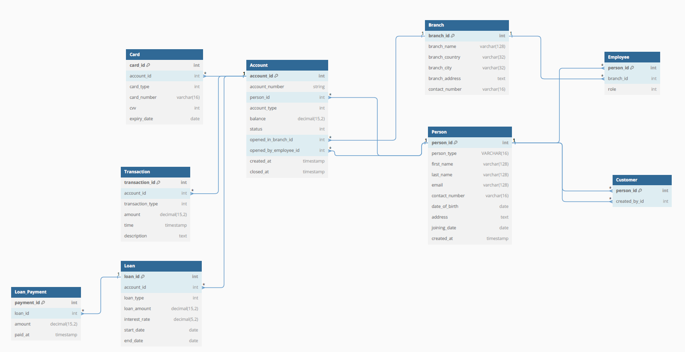
Step One : Database Schema Design

Slide 5
ENTITIES : - PERSON, CUSTOMERS , ACCOUNTS, TRANSACTIONS, LOANS, LOANS PAYMENT , BRANCHES, EMPLOYEES, CARD . RELATIONSHIPS : - PERSON (PARENT) ARE LINKED TO CUSTOMER AND EMPLEYEE - CUSTOMERS CAN HAVE MULTIPLE ACCOUNTS IN DIFFERENT BRANCHES - AN ACCOUNT HAS A CARDS - EACH ACCOUNT CAN HAVE MULTIPLE TRANSACTIONS - LOANS ARE LINKED TO ACCOUNT AND BRANCHES - LOAN PAYMENT HAS LINKED TO LOANS - EMPLOYEES BELONG TO BRANCHES
Step Two : ERD (Entity Relationship Diagram)

Slide 6
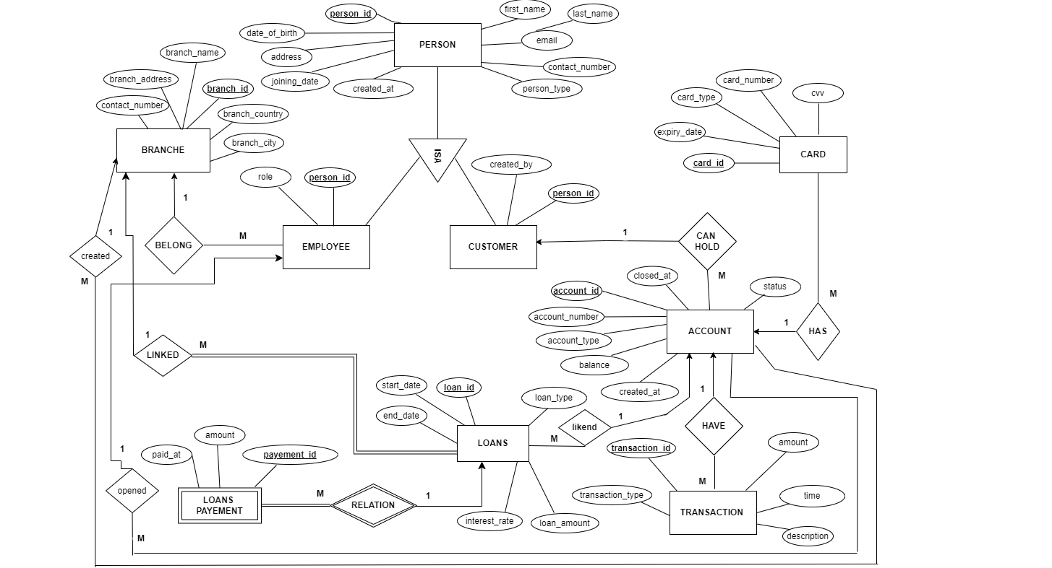

Slide 7
Thank You For Your Attention.

